Slide 1
Emilees Animal Slide Show
18/1/24/11

Slide 2
The animal I researched hardly ever leaves it’s herd.

Slide 3
The animal I researched eats grass,hay he or she eats any kind of plant.

Slide 4
The animal I researched is a hervabor because it eats plants.

Slide 5
1.The animal I researched can live in the wild for 25 years but if being protected 30years.

Slide 6
2.The animal I research is fairly sedentairy animals,only travileling for
feed ,water and breeding.

Slide 7
3.Interesting fact is a blank is the most largestof all the species.

Slide 8
4. Interesting thing I learned is that the animal I reseached young will stay with them for 2or3 years.

Slide 9
The 5th interesting thing is that it sound like a
pig and lion.

Slide 10
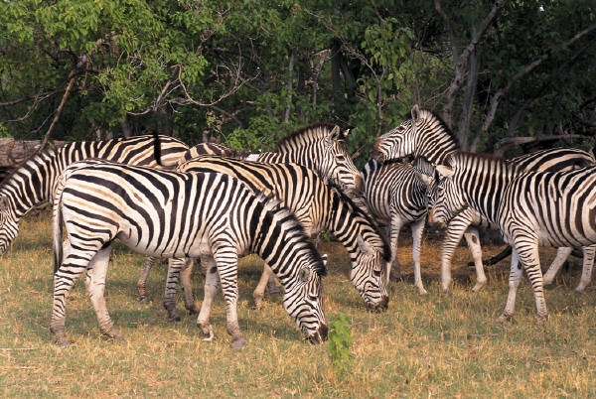

Slide 11
The most inportant thing I learnd is that a zebra can live for 25 yaers but being protected 30years..

